Slide 1


Slide 2
Bingwei Liu
Proprietary and Confidential

Slide 3
From H2O to Steam
Proprietary and Confidential

Slide 4
Agenda
H2O at Aetna
Enterprise Steam
Packrat
Q&A
Demo

Slide 5

History
2015
2016
2017
2018
A small group of employees went to H2O World 2015
Enterprise support. Early adoption in various projects. A couple production models.
Enterprise Steam in production. Regular training and webinar series. A boost of usage.
The journey continues….


Slide 6
We learn and grow together with H2O team
Contribution
Secure impersonation in Kerberized Cluster
Improvement
Add new Features to H2O and Steam
Training
In person
Webinar
Frequent
On demand
In-depth

Slide 7
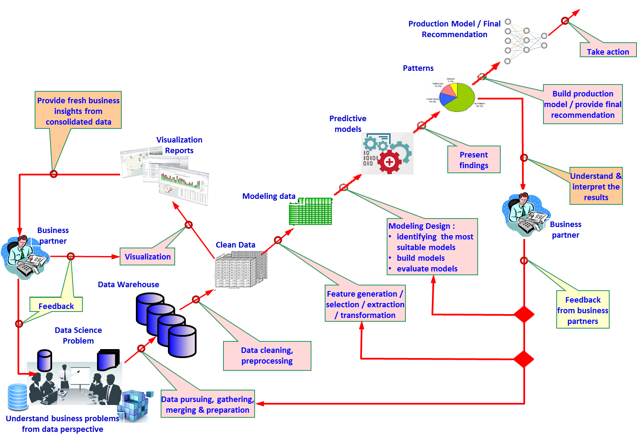
Analytics Pipeline
Credit: Aleksandar Lazarevic

Slide 8
Engineering Pipeline

Slide 9
Use Cases
Problems

ER revisit

Overpayment

Customer Experience
Algorithms
GBM
RF
Dataset Size
> 50x

Slide 10
Agenda
H2O at Aetna
Enterprise Steam
Packrat
Q&A
Demo

Slide 11
To Use H2O on YARN
X
Linux CLI
Browser
RStudio
Download H2O
Create H2O cluster
Access Flow URL
Connect to H2O Cluster
Danger!

Slide 12
A Simple Fix
Create a username and password for flow
Create a properties file with username and MD5 of password
Use the properties file in hadoop jar command

Slide 13
Enterprise Steam
Security
Customized Profile
User Experience
Integrate with Active Directory Service
YARN queue
Easy to use Web UI
Secure impersonation in Hadoop
User Identities
Don’t need UI if you don’t want to
Resource limitations

Slide 14
Enterprise Steam Web UI
User Authentication with AD

Slide 15
Launching a Cluster
Limit the size of H2O Cluster
How much data each node can fit?
YARN Queue integration
Support multiple version of H2O

Slide 16
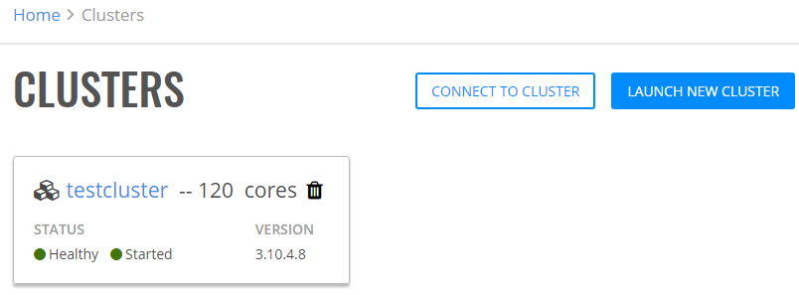
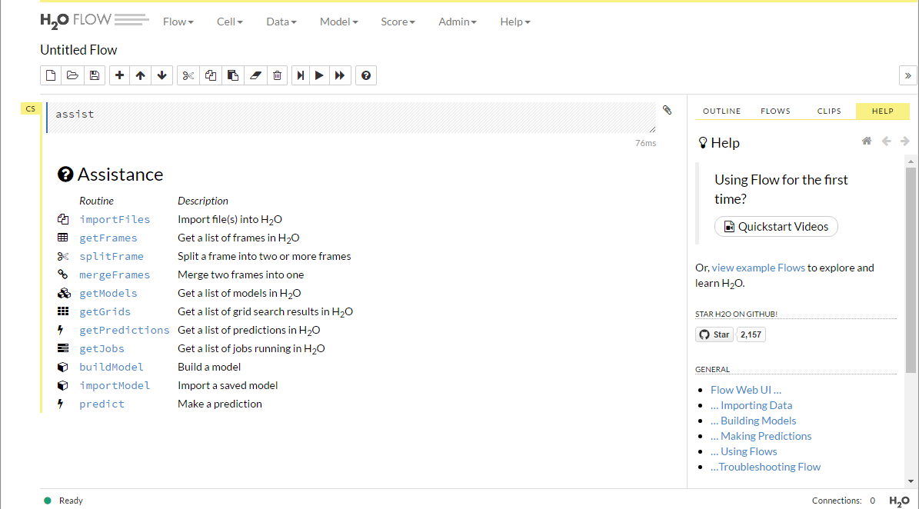
Secured H2O Flow
Steam uses proxy to secure Flow for each cluster
https://steam.server.com:9999/username_clustername/flow/index.html
Only the user who created the cluster will be allowed to open flow
Click

Slide 17
Connecting to an H2O Cluster
After an H2O Cluster is created from Steam UI
Danger!

Slide 18
Encrypt User Password
Use digest package to encrypt/decrypt passwords
Encrypted password saved in a fix location under the user’s home folder
Load the encrypted password and decrypt

Slide 19
User Experience
Linux CLI
Browser
RStudio
Download H2O
Create H2O cluster
Access Flow URL
Connect to H2O Cluster
Browser
Browser
RStudio
Create H2O cluster
Access Flow URL
Connect to H2O Cluster
RStudio
Create H2O Cluster
Browser
Access Flow URL
Login to steam
RStudio
RStudio
Connect to H2O Cluster

Slide 20
No Browser Needed!

Slide 21
Agenda
H2O at Aetna
Enterprise Steam
Packrat
Demo
Q&A

Slide 22
About Packrat
R Project
Isolated
Portable
Reproducible
Dependency management system for R
Notes:
Packrat is a dependency management system for R. Use packrat to make your R projects more:
Isolated: Installing a new or updated package for one project won’t break your other projects, and vice versa. That’s because packrat gives each project its own private package library.
Portable: Easily transport your projects from one computer to another, even across different platforms. Packrat makes it easy to install the packages your project depends on.
Reproducible: Packrat records the exact package versions you depend on, and ensures those exact versions are the ones that get installed wherever you go.

Slide 23
Use Packrat
Create a RStudio with Packrat enabled
Install h2o and h2osteam packages, likely installed from source
Take a snapshot using packrat
Put any R scripts needed for the users
Bundle the R project
Users:
Run one shell script to unpack the project
No more manual installation of packages

Slide 24
Use Packrat
But…
What if you need a specific version of h2o?
Workaround:
Create a local repository under the project folder
Modify packrat.lock file for destination location

Slide 25
Agenda
H2O at Aetna
Enterprise Steam
Packrat
Demo
Q&A

Slide 26
DEMO
Enterprise Steam
R Project

Slide 27
Agenda
H2O at Aetna
Enterprise Steam
Packrat
Q&A
Demo

Slide 28
Questions
Proprietary and Confidential

